Slide 1
HISTORY
CHAPTER - 1
Class 12
BRICKS, BEADS AND BONES

Slide 2
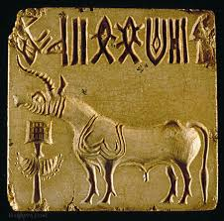
INTRODUCTION
One of the world’s oldest urban civilizations (Indus Valley)
Known for planned cities, advanced technology, and trade
Time span: 6000 BCE – 1300 BCE
Major phases:
Early Harappan: 6000 – 2600 BCE
Mature Harappan: 2600 – 1900 BCE
Late Harappan: 1900 – 1300 BCE

Slide 3
Terminologies, Places & Time
Harappan Civilisation = Indus Valley Civilisation
Named after Harappa (first site discovered)
Spread across present-day Pakistan & northwest India
Key states: Punjab, Haryana, Rajasthan, Gujarat, Maharashtra
Found as far as Afghanistan and Baluchistan

Slide 4
Beginnings
Origin from early farming communities (~7000 BCE)
Early Harappan phase: small settlements, agriculture, and crafts
Urban phase evolved through gradual growth

Slide 5
Subsistence Strategies
Ate wheat, barley, lentils, chickpeas, sesame, millets, rice
Domesticated animals: cattle, sheep, goat, buffalo, pig
Also hunted: boar, deer, gharial, fish, fowl
Evidence from charred grains & animal bones

Slide 6
Agricultural Technologies
Oxen used for ploughing (evidence from seals & models)
Ploughed fields at Kalibangan – two crops together
Tools for harvesting: stone or metal blades
Irrigation possible through wells, reservoirs (Dholavira)
Canals found at Shortughai (Afghanistan)

Slide 7
Mohenjodaro – Planned Urban Centre
City divided into Citadel (higher) & Lower Town (larger, lower)
Planned streets in grid pattern
Standardised bricks (ratio 4:2:1)
Huge labour force mobilised for construction

Slide 8
Domestic Architecture – Harappan Cities
Most houses built with baked or sun-dried bricks
Layout centred around a courtyard – main family activities like cooking, weaving happened here
Rooms on all sides of the courtyard
Main entrance faced away from the street for privacy
No windows on ground-level walls facing the street
Each house had a bathroom paved with bricks, connected to street drains
Some houses had staircases to a second floor or roof
Many houses had private wells; in Mohenjodaro, about 700 wells have been found

Slide 9
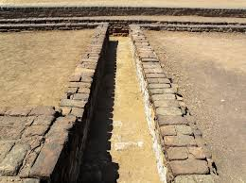
Drainage System
Covered brick drains along streets
Houses connected to drains via bathrooms
Cesspits for waste settlement before water entered street drains
Found in big & small towns

Slide 10
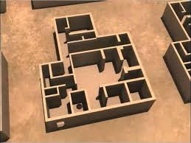
Domestic Architecture
Houses around a central courtyard
Main door faced away from street (privacy)
Many had wells & staircases
Bathrooms paved with bricks

Slide 11
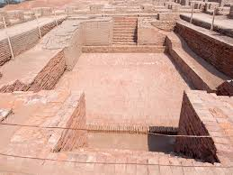
Citadel Structures
Great Bath – watertight pool for ritual bathing
Warehouse – massive structure for storage
Other public buildings

Slide 12
Tracking Social Differences
Burials: Most graves simple, some with ornaments & pottery
Luxury items: Rare materials like gold, faience, semi-precious stones
Luxuries found mostly in large cities

Slide 13
Craft Production
Centres like Chanhudaro specialised in beads, shells, seals, weights
Beads made from carnelian, jasper, steatite, gold, faience
Coastal towns (Nageshwar, Balakot) made shell goods

Slide 14
Procuring Materials
Local & long-distance trade
Raw materials from:
  Rajasthan (copper)
  Gujarat (carnelian)
  Afghanistan (lapis lazuli)
  South India (gold)
Bullock carts, river & sea routes used

Slide 15
Contact with Distant Lands
Trade with Oman, Bahrain (Dilmun), Mesopotamia (Meluhha)
Harappan seals, beads, weights found abroad
Mesopotamian texts mention Meluhha goods

Slide 16
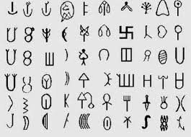
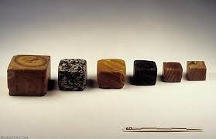
Seals, Script, Weights
Seals: for identification, security in trade
Script: undeciphered, 375–400 signs, right-to-left
Weights: chert stone, binary & decimal system

Slide 17
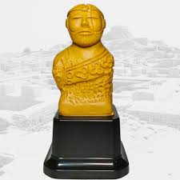
Ancient Authority
Evidence of organised planning & standardisation
Debate: single ruler, many rulers, or equal society
Likely coordinated governance for large-scale works

Slide 18
End of the Civilisation
Around 1900 BCE: cities declined
Reasons: climate change, floods, river shifts, overuse of land
Loss of trade, writing, standard weights
Rural lifestyle replaced urban centres

Slide 19
Discovering the Harappan Civilisation
Forgotten until 19th century
Alexander Cunningham (1875) found seal but misdated it
John Marshall (1924) announced discovery
Later excavations revealed many sites

Slide 20
Problems of Piecing Together the Past
Script undeciphered – rely on material evidence
Finds classified by material & function
Religious beliefs hard to interpret – figurines, seals, altars
Some ideas speculative (e.g., proto-Shiva)

Slide 21
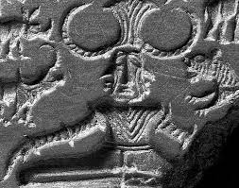
Problems of Piecing Together the Past
Script undeciphered – rely on material evidence
Finds classified by material & function
Religious beliefs hard to interpret – figurines, seals, altars
Some ideas speculative (e.g., proto-Shiva)

Slide 22
THANK YOU ALL!

